Slide 1

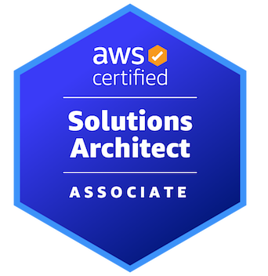

AWS CERTIFIED SOLUTIONS ARCHITECT - ASSOCIATE
AWS Cloud Practitioner Refresher
AMBER ISRAELSEN
Developer | Technical Trainer
Notes:
m2-01 = “Module Introduction”
Hi folks, and welcome to this next module in the AWS Certified Solutions Architect Associate course. I’m Amber Israelsen.

Slide 2
Course Outline (Part 1)
Course Introduction
AWS Cloud Practitioner Refresher
Authentication and Authorization – Identity and Access Management (IAM)
Compute
Elastic Load Balancing and Auto Scaling
Networking
Storage
Databases
Data Migration and Transfer
Analytics
Notes:
This module is going to be a refresher of the important concepts and services from the Cloud Practitioner course and certification. We’ll also do some demos to set up the AWS Command Line Interface. If you’re feeling pretty confident about these areas, feel free to skip ahead of the next module, but I just wanted to get us all on the same page as we’re kicking off.
All right. Let’s get going.

Slide 3
Availability Zone
A single data center or group of data centers within a region, each with redundant power, networking and connectivity, housed in separate facilities
Notes:
m2-02 = “AWS Infrastructure Concepts”
The AWS Cloud infrastructure is built around Regions and Availability Zones (“AZs”). You can see the different regions here in blue—____ at the time of this recording, with several more on the way.
And you can also see them in the AWS Console from the region dropdown (show this). The one you choose will depend on where your customers are, whether you have regulatory requirements to be in a certain location, and whether the services you need are available in that region (not all services are in all regions).
Then each region contains two or more availability zones.
An availability zone is a single data center or group of data centers within a region, each with redundant power, networking and connectivity, housed in separate facilities.
This means if there’s some sort of disaster with one data center or availability zone—things can fail over to the other one that might be several miles away, on separate power and so on. But they’re still close enough to each other that you have low latency or speed between the zones.

Slide 4
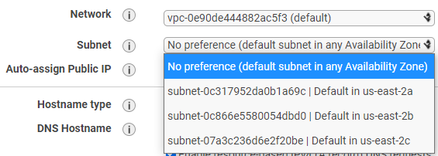
Notes:
And you can see the availability zones in various places in the console, such as when you go to create a new EC2 instance and under subnet, you’ll see something like 2a, 2b, 2c and so on.

Slide 5
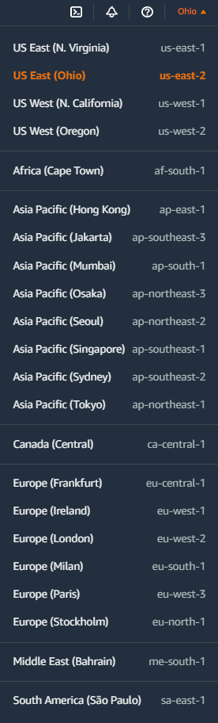
Regions and Availability Zones
Region (e.g., us-east-2)
Availability Zone/Data Center 1
e.g., us-east-2a
Availability Zone/Data Center 2
e.g., us-east-2b
Availability Zone/Data Center 3
e.g., us-east-2c
Instances
Instances
Instances
Notes:
So pulling it all together.
A region is divided into two or more Availability Zones. An Availability Zone corresponds with a physically isolated datacenter in the geographic region. If you deploy your application servers to separate Availability Zones, a hardware or connectivity outage affecting one zone does not impact any servers hosted in other zones.

Slide 6
Edge Location
A site that Amazon CloudFront uses to store cached copies of your content closer to your customers for faster delivery
Notes:
So we’ve talked about regions and availability zones, but I also need to mention edge locations, which are sites used by Amazon CloudFront to store cached copies of your content closer to your customer for faster delivery.
You don’t need to know all the details of CloudFront at the moment, but just know that it’s a content delivery network, or CDN, something skin to an Akamai or Fastly. If your site is serving up videos or images or what have you, the whole job of CloudFront is to get them there faster.
And here are the various edge locations around the world: https://aws.amazon.com/cloudfront/features/?whats-new-cloudfront.sort-by=item.additionalFields.postDateTime&whats-new-cloudfront.sort-order=desc. You’ll see there’s a lot.
You obviously won’t need to memorize any of this, but for the exam, if you get questions around fast delivery of content to customers around the world, think edge locations and CloudFront.

Slide 7

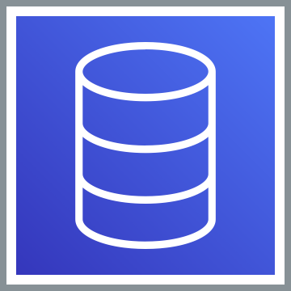
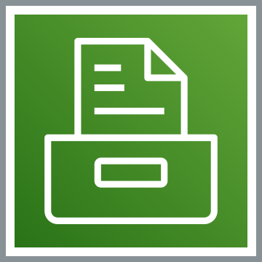
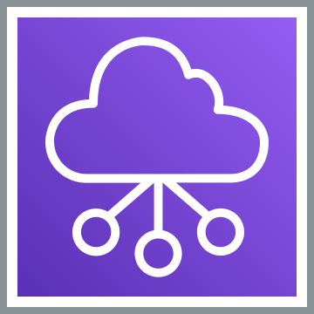

Foundational Services
COMPUTE: Elastic Compute Cloud (EC2)
DATABASE: Relational Database Service (RDS) and DynamoDB
STORAGE: Simple Storage Service (S3)
NETWORKING: Virtual Private Cloud (VPC)
SECURITY: Identity and Access Management (IAM)
Notes:
m2-03 = “Core AWS Services”
AWS is made up of what are called services. There are literally hundreds of these as of today’s recording, but there are just a handful that are foundational to everything else.
Read through them on the slide, animating.
COMPUTE: The service here is called Elastic Compute Cloud (EC2) – think of these as your computers in the cloud
DATABASE: There are two big categories of databases—relational, where your data is stored in structured tables, and then non-relational databases that have a more flexible structure. In AWS land, these are the Relational Database Service (RDS) and DynamoDB.
STORAGE: Simple Storage Service (S3)—think of this as where you store images and other files
NETWORKING: Virtual Private Cloud (VPC)—this is your private network in the cloud
SECURITY: Identity and Access Management (IAM)—this is where you create and manage users and their permissions.
For these services, you’re billed for what you use, like we said earlier, and AWS provides lots of tools to manage every bit of it, including detailed drill-downs of what you’re spending and where.
As I said, stay tuned for a lot more, but this might be a good reference slide for you as you start learning about the foundational services.

Slide 8
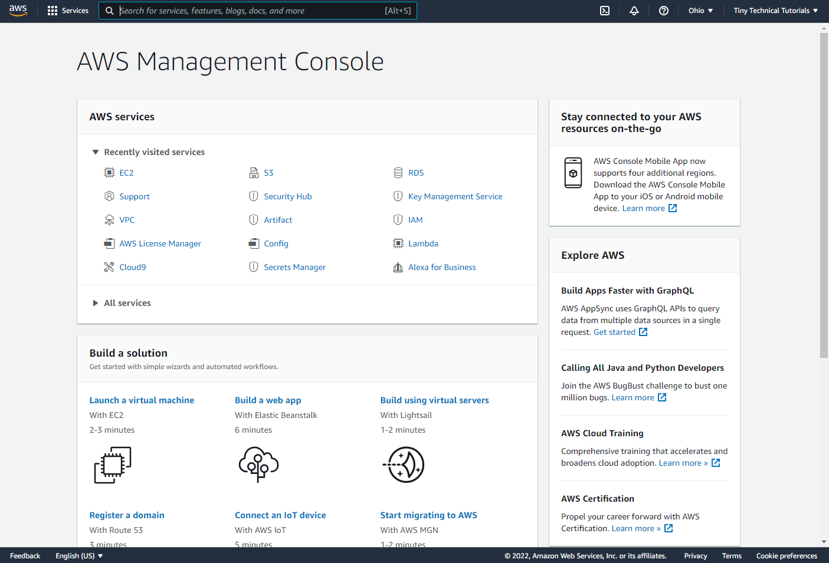
AWS MANAGEMENT CONSOLE
Notes:
m2-04 = “An Overview of Ways to Work with AWS”
Let me start by giving you a quick overview of the four different ways to work with AWS. First is the AWS Management Console. This is the browser-based console that we’ve already seen a lot in this course, and I walked you through how to create an account in the beginning of the course.

Slide 9
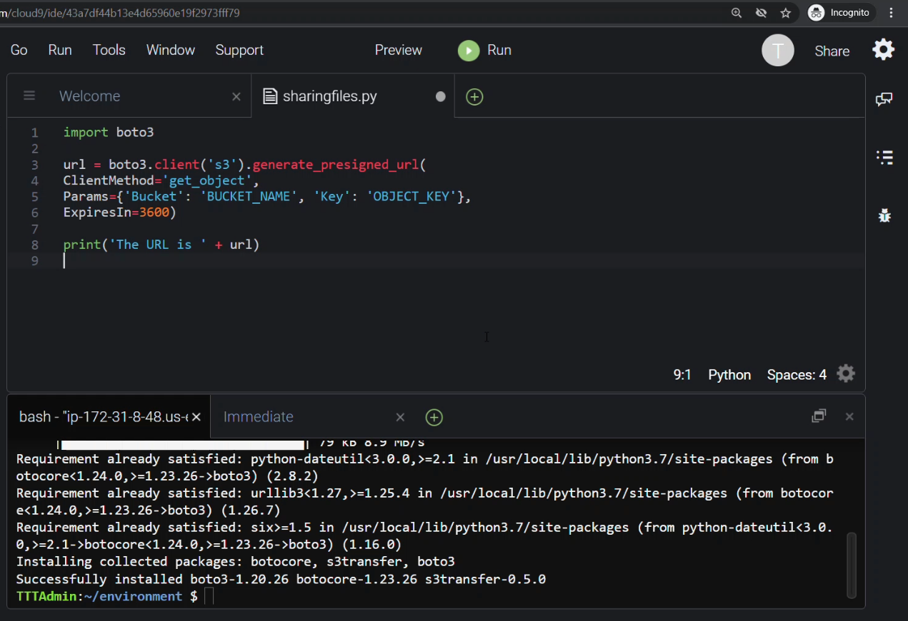
SOFTWARE DEVELOPER KIT (SDK)
Notes:
Then we have the software development kit, or SDK, which is how you’re able to write code against AWS. There are different flavors of the SDK, including for .NET, Python, PHP, Java, JavaScript, Go, Node and Ruby. We won’t really be working with the SDK much in this course, but if you’re a developer, know that you have plenty of options for working programmatically with AWS.

Slide 10
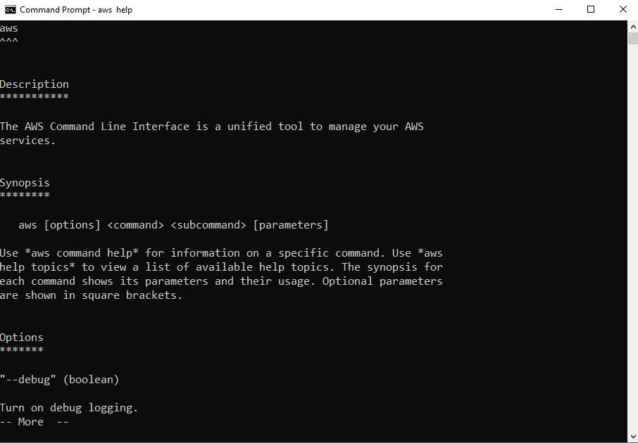
COMMAND LINE INTERFACE (CLI)
Notes:
Then we have the command line interface or CLI. This lets you do the same things you can do in the browser, but from the command line instead. And actually, there are some additional things you can do in the CLI that you CAN’T do in the browser. It’s kind of personal preference which one you use, but some folks find this can be faster, especially if you have repetitive or bulk commands that you need to run.

Slide 11
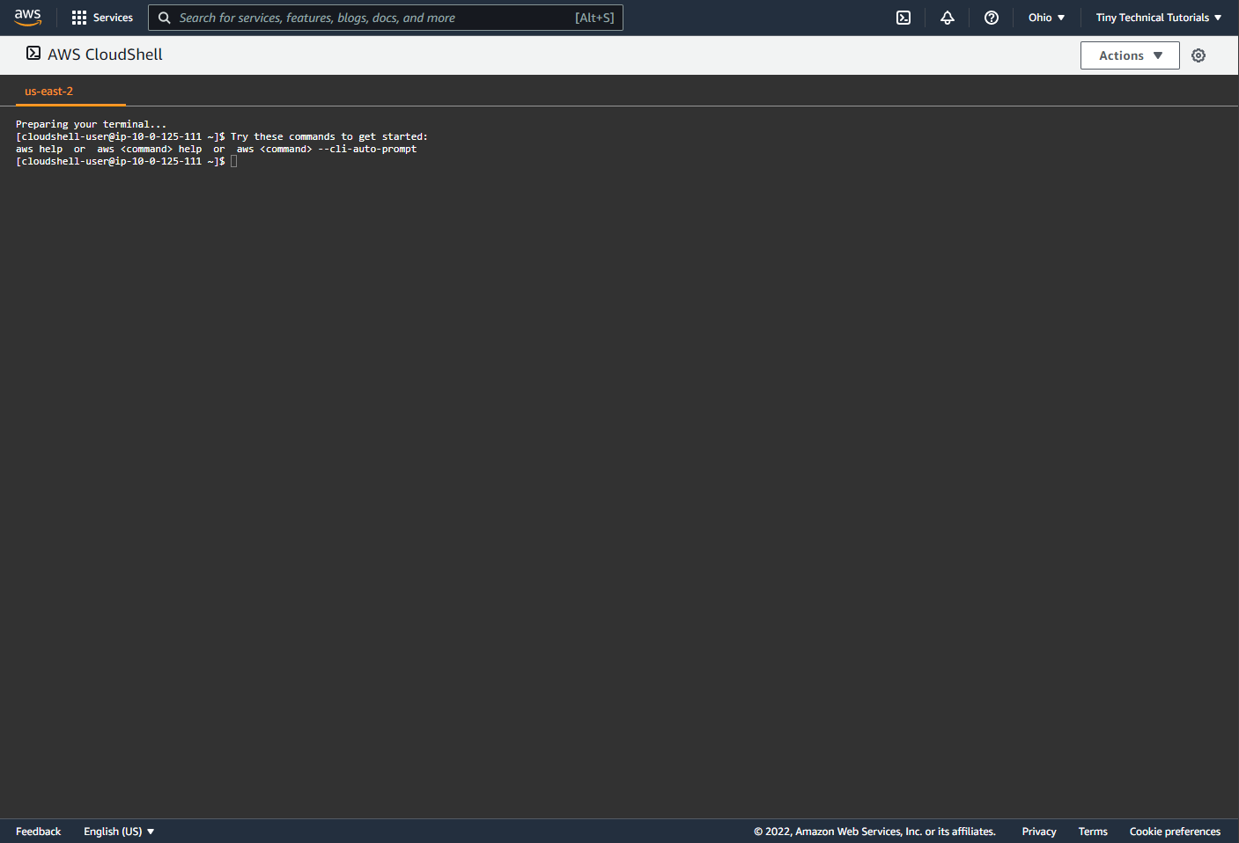
AWS CLOUDSHELL
Notes:
And then we also have AWS CloudShell, a relatively new addition to the toolset. This is basically the same as the CLI, but it runs in the browser, and doesn’t require the same initial configuration and credentials that the CLI requires running on your local computer. So generally easier and faster to get going.

Slide 12
DEMO
Installing the AWS CLI on Windows
Notes:
m2-05 = “DEMO: Installing the AWS CLI on Windows”
In this video, I’ll show you how to install the AWS CLI on a Windows machine.
Google AWS CLI download, go here: https://docs.aws.amazon.com/cli/latest/userguide/getting-started-install.html
The latest is version 2, and then expand Windows
Download the MSI, then run it
Go to Start→cmd
Type aws –version to ensure it installed properly; you should get output like this
Okay. So that’s how to install the CLI, but you won’t be able to do much with it until we configure it. So be sure you watch that upcoming video about how to Configure the AWS CLI.

Slide 13
DEMO
Installing the AWS CLI on Linux
Notes:
m2-05 = “DEMO: Installing the AWS CLI on Linux”
SETUP: Create a Linux EC2 instance with MATE UI and RDP open
Create new Linux 2 instance (search for “MATE” in the title, which is the Linux GUI)
Create new security group, add port for RDP 3389, from my IP
SSH into machine using EC2 Instance Connect (connect as ec2-user)
Do an update for the latest – must do this or get error about authentication not enabled when logging in??
sudo yum update -y
Update password for ec2-user
sudo passwd ec2-user
Make it Erroneous123#
Get public IP address
Go to RDP client on my laptop
Before connecting, enter user name of ec2-user (have to click the options button to get this to display)
If RDP session disconnects immediately, try rebooting instance
Open browser (Chromium) and Google AWS CLI download
Don’t download the zip (use commands below)
Open MATE terminal and enter these commands (copy from download documentation):
curl "https://awscli.amazonaws.com/awscli-exe-linux-x86_64.zip" -o "awscliv2.zip“
unzip awscliv2.zip
sudo ./aws/install
aws --version
Okay. So that’s how to install the CLI, but you won’t be able to do much with it until we configure it. So be sure you watch that upcoming video about how to Configure the AWS CLI.

Slide 14
DEMO
Installing the AWS CLI on Mac
Notes:
m2-06 = “DEMO: Installing the AWS CLI on Mac”
Log in to Mac instance using VNC Viewer
Open browser and Google AWS CLI download
Follow instructions
End with:
aws --version
Okay. So that’s how to install the CLI, but you won’t be able to do much with it until we configure it. So be sure you watch that upcoming video about how to Configure the AWS CLI.

Slide 15
DEMO
Configuring the AWS CLI on Windows, Mac, Linux
Notes:
m2-06 = “DEMO: Configuring the CLI on Linux, Windows and Mac”
All right. You’ve got the AWS CLI installed on whatever your operating system is—whether it’s Windows, Mac or Linux, but if you try to do something with it—like list your S3 buckets out (aws s3api list-buckets, show this), you’ll see that it doesn’t work, and it prompts you for credentials. And even a helpful command that we need to run “aws configure.” So let’s do that.
Now, it’s going to prompt you for four things here: (use callouts to show):
Access key ID
Secret access key
AWS Region
Output format
Let’s talk about the first two—the access key ID and secret access key. These are required for any kind of programmatic access in AWS, and they’re used to sign the requests you make to AWS.
To get the ID and key, let’s go into the AWS Console→IAM→Your user account
Now, a super important note here. I’m logged in as an IAM user with admin permissions. I’m NOT using my root account. As a best practice, you generally don’t want to use the root account for any kind of day-to-day work. Use an IAM user instead with the least amount of privileges you need to accomplish your tasks. So I’m just logged in as an IAM user admin now.
Click on Security Credentials and then Create access key.
Once you do that, you’ll get a few messages that are worth repeating here. These keys should be treated like any other passwords or credentials you have—don’t share them with others and definitely don’t post them on public platforms GitHub or otherwise check them into your source control system.
Also, this is the ONLY time the keys can be viewed or downloaded. If you lose the keys, you can’t retrieve them, but you can always come back here and create new keys, though you can only have a maximum of two access keys at a time.
So let me copy these into our CLI prompt… (copy ID and secret access key) (I WILL invalidate these just as soon as I’m done, so it’s fine for you to see them right here)
Next up, we need the default region. This will vary depending where you are in the world. If you need to check the options, come into the console here.
us-west-2
And finally, the output format—here you get to pick how the results in the CLI are formatted. The default is JSON, if you don’t specify anything, but you can also choose YAML, YAML-stream, TEXT or TABLE.
Enter json (HAS to be lower case)
Okay, so we should be good to go.
Now, behind the scenes, what happened is the CLI stored the configuration and credential information in a local file in your home directory. The location of this will depend on your operating system. In Windows, it’s %UserProfile% and then a folder called .aws. On Unix-based systems, it’ll be $HOME or ~ (tilde). And here you’ll see the files for config and credentials. And if you open them up, there’s the information we entered.
And so in the future when you open the CLI again and use it, it’s going to pull the information from these files to get you connected and execute the commands against AWS.
All right. Finally, let’s test that everything works as expected.
I have some S3 buckets I had created previously (show in the Console).
Let’s use the CLI to list out those buckets.
aws s3api list-buckets
And voila, it all works! So the CLI is configured and ready to use.

Slide 16
DEMO
Working with AWS CloudShell
Notes:
m2-07 = “DEMO: Working with AWS CloudShell”
Start in Console on home page.
We saw how to configure the AWS CLI when it’s running on your local computer—having to configure it with your credentials.
But there’s actually an easier way to do all of that, and that’s with CloudShell. Click CloudShell. Now, if you don’t see this option in your browser, it might not be available in your region. If you Google “aws cloudshell region availability,” you’ll eventually get to https://docs.aws.amazon.com/general/latest/gr/cloudshell.html. So if you’re in a different region, you’ll need to toggle to one of those regions where it’s available. I’m in us-east-2 (or whatever) where it IS available.
And as you’ll see from the pop-up window here, AWS CloudShell is a browser-based shell where you can access your AWS resources on the command line, with various tools already installed. So it’s basically the same as the CLI we saw a second ago on my local computer, but in the browser. And right away, you’ll see you can issue commands like aws –version. Or aws s3api list-buckets, and you don’t have to do that aws configure step with credentials and so on. That’s because it’s basically done that work for you behind the scenes. So the credentials you used to log into the console here, it’s taking those credentials and that’s how it’s authenticating you in to use CloudShell.
You can also open new tabs, so easily getting a second instance of the shell. Increase font size and so on.
There’s also persistent storage behind this, meaning if do something like this:
echo “hello world" > demo.txt
This will create a file called demo.txt, and inside of it will be the words “Hello World.” If you do an ls, then that will list your files (showing demo.txt). And if you end this CloudShell session (close), those files will still be there, and you get up to 1GB storage per region. You can download and upload files. Download demo.txt to desktop and open it.
But in short, this is an easy alternative to using your local terminal for issuing commands against your AWS resources.
Delete the files afterwards
rm demo.txt

Slide 17
Important Points to Remember
FOUNDATIONAL SERVICES
Compute: Elastic Compute Cloud (EC2)
Database: Relational Database Service (RDS) and DynamoDB
Storage: Simple Storage Service (S3)
Networking: Virtual Private Cloud (VPC)
Security: Identity and Access Management (IAM)
Notes:
m2-10 = “Cloud Practitioner Refresher: Important Points to Remember”
As we close up this module, let’s recap the important points from this refresher.
FOUNDATIONAL SERVICES
Compute: Elastic Compute Cloud (EC2)
Database: Relational Database Service (RDS) and DynamoDB
Storage: Simple Storage Service (S3)
Networking: Virtual Private Cloud (VPC)
Security: Identity and Access Management (IAM)

Slide 18
Regions, Availability Zones and Edge Locations
Region (e.g., us-east-2)
Availability Zone/Data Center 1
e.g., us-east-2a
Availability Zone/Data Center 2
e.g., us-east-2b
Availability Zone/Data Center 3
e.g., us-east-2c
Instances
Instances
Instances
Edge locations are used by CloudFront to get content closer to customers
High availability = 2 or more AZs
Withstand environmental disaster = deploy to 2 or more regions
Notes:
For terminology, just to recap on regions and availability zones.
A region is a geographical part of the world—like us-east-2 or eu-west-1. And it’s divided into two or more Availability Zones. An Availability Zone corresponds with a physically isolated datacenter in the geographic region, and that’s where you deploy your resources.
We also talked about Edge locations, which are used for CloudFront—the content delivery network—to get content closer to customers—things like video files.
And remember that if you want something to be highly available, it needs to be in two or more AZs.
And if you need something that is tolerant to an environment disaster, such as an earthquake, which could take out all the AZs in a single region, you’ll want to be deployed in two or more regions.

Slide 19
Important Points to Remember
WAYS TO WORK WITH AWS
AWS Management Console (browser)
Programmatic access
From your local machine – both require access key IDs and secrets
Software Developer Kit (SDK)
Command Line Interface (CLI)
AWS CloudShell
Browser-based; doesn’t require access key ID
Notes:
We saw four different ways to work with AWS:
AWS Management Console (browser)
For Programmatic access, we have three options:
From your local machine – both require access key IDs and secrets; we saw how to install and configure these
Software Developer Kit (SDK)
Command Line Interface (CLI)
Then we also saw AWS CloudShell
Browser-based; doesn’t require access key ID

